Slide 1

Real-Time Big Data Analytics with Storm and Trident
OCTOBER 2014
Ron Bodkin – Founder & President Think Big, a Teradata company
Altan Khendup – Big Data Architect

Slide 2
Agenda
Who is ThinkBig?
Storm Refresher/Concepts
Why Storm?
Where do we use Trident?
Future
Hortonworks Support, New Features, Growing Adoption

Slide 3
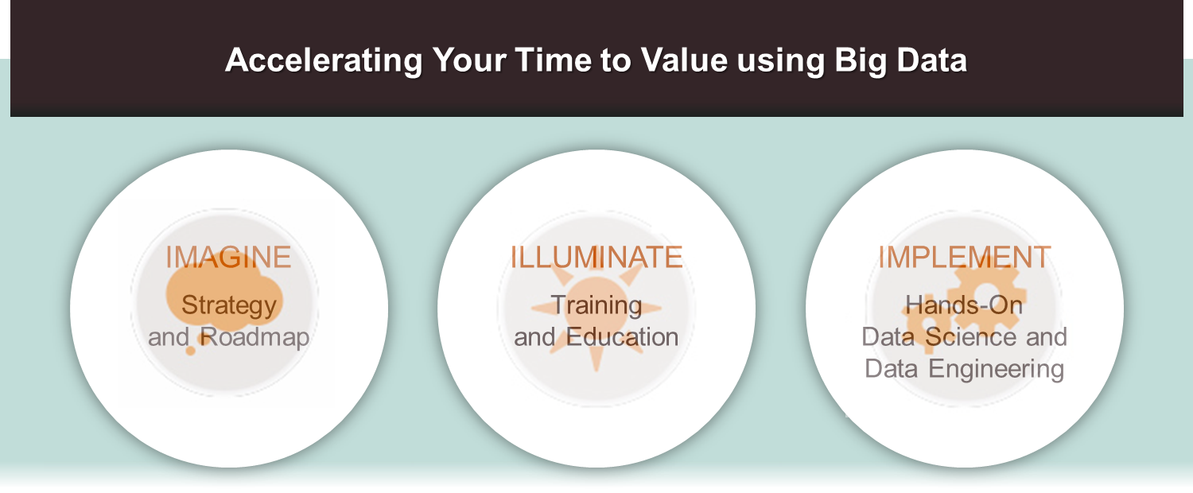
Leading Provider Data Science and Engineering Services
Notes:
That is what we do.
Think Big Analytics provides data science and engineering services that create value from Big Data
We help you IMAGINE your possibilities for big data and identify a plan for profitable projects
We ILLUMINATE your team through training and education on the latest in big data technologies
We then help you IMPLEMENT your analytics plan with hands-on data scientists and engineers who rapidly build data solutions to deliver value.

Slide 4

Storm Refresher
DAG Processing of never ending streams of data
Open Source: http://storm.incubator.apache.org
Used at Twitter plus many other companies
Reliable – At Least Once semantics
Think MapReduce for data streams
Java/Clojure based
Bolts in Java and “Shell Bolts”
Not a queue, but usually reads from a queue
Related:
Spark Streaming, Samza, SQLstream, IBM, Tibco, Cask
Compromises
Static topologies & cluster sizing – Avoid messy dynamic rebalancing
Reliability: Nimbus SPOF (soft failure)
State not built-in
Community support, Hortonworks commercial support

Slide 5
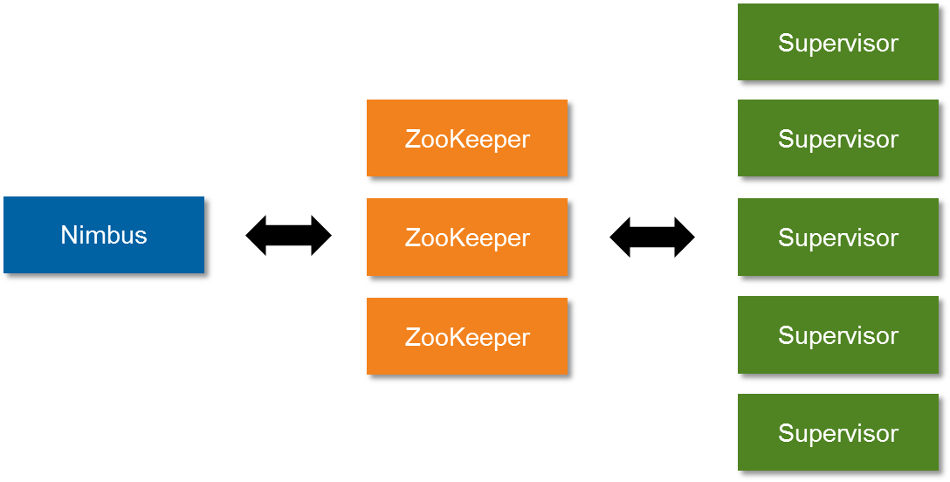
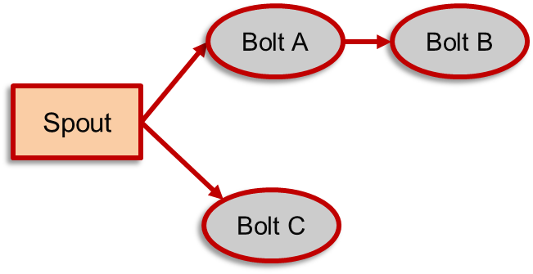
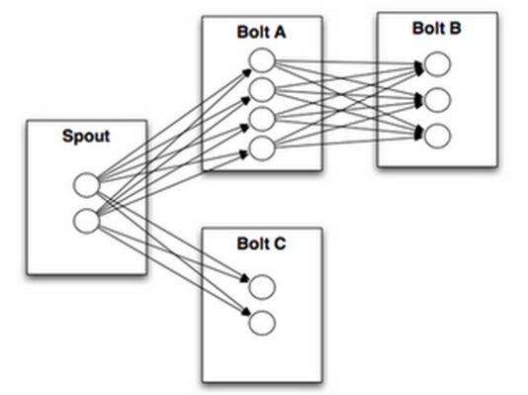
Storm Concepts
Cluster
Nimbus
Zookeeper
Supervisor, Workers
Topology
Streams
Tuple
Spout
Bolt
Stream Groupings
Shuffle, field
Trident
DRPC

Slide 6
Why Storm?
Scalable way to manage queue readers and logic pipeline
Much better than roll your own
Reliable (Message guarantees, fault tolerant)
Fast (over 1MM messages/node/s in some tests)
Multi-node scaling
It works
Open source community
It runs on YARN
See also: https://github.com/nathanmarz/storm/wiki/Rationale

Slide 7
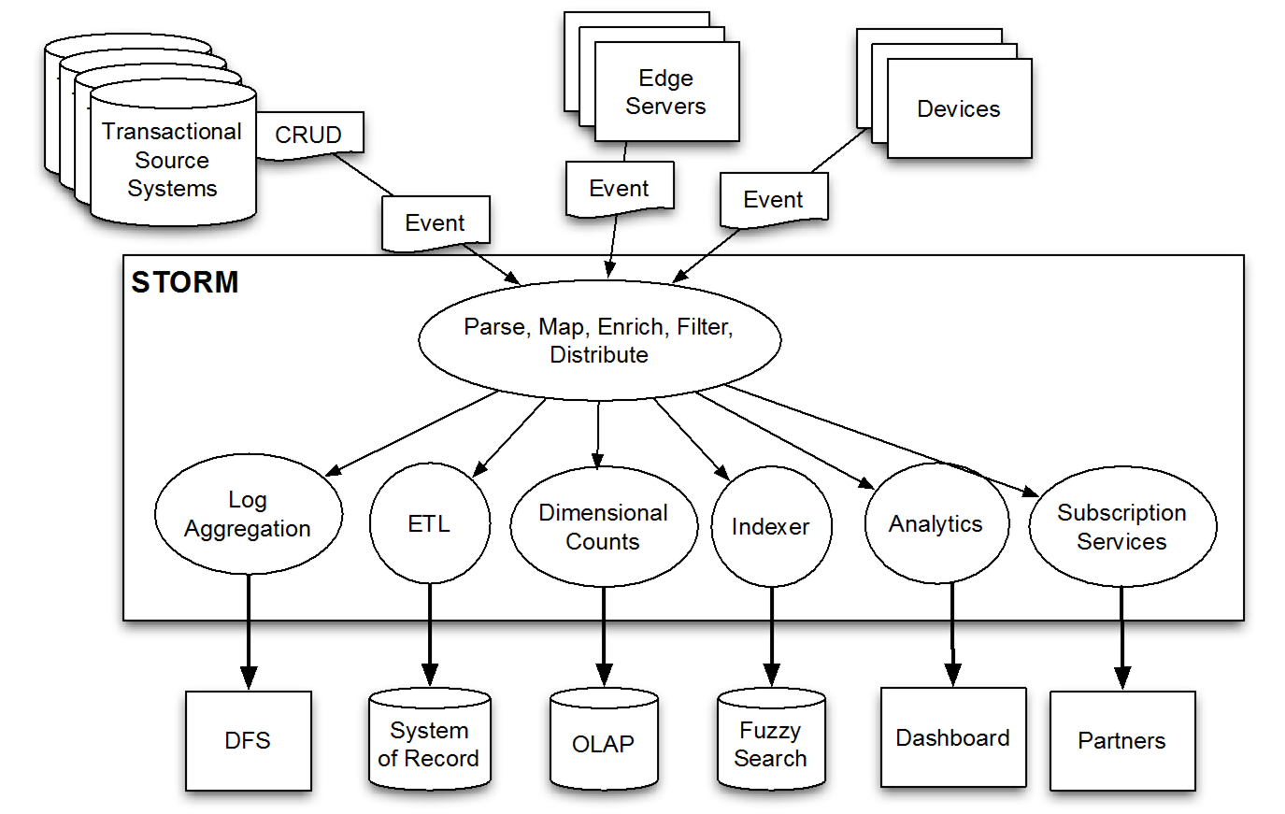
Where do we use Storm/Trident?

Slide 8
Why Trident?
When you need:
Once and Only Once Semantics – “One and Done”
Transactional Topologies
Convenient Abstractions for Persistent Aggregates
Concepts familiar to Pig & Cascading users
Joins, Grouping, Aggregation, Functions, Filters
Stateful Incremental processing on top of data stores
Examples & Use Cases
Processing a batch upload of invoices
Unpacking an archive of log events
Windowed moving average
Trending topics

Slide 9
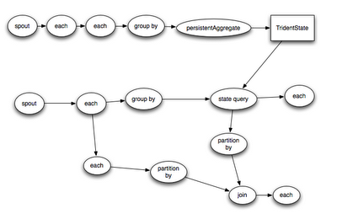
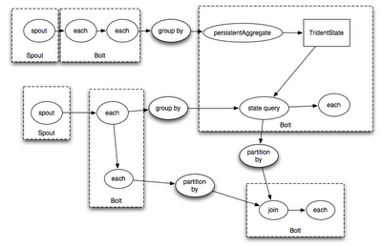
What is Trident exactly?
Trident is
Abstraction on top of Storm Infrastructure
Topology
Divided into streams
Optimized
DRPC compatible
Added to Storm 0.8.0 – Aug 2012
Trident is not
Compatible with Storm topologies, bolts and spouts
Source: https://blog.twitter.com/2012/trident-high-level-abstraction-realtime-computation

Slide 10
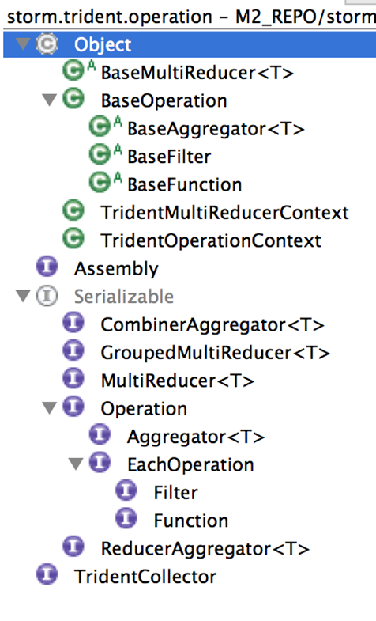
Trident Operations
Filters
Functions
Aggregators
Reducers

Slide 11
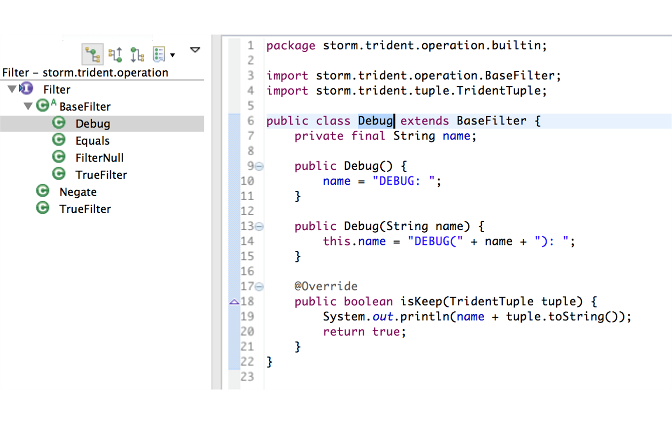
Filters

Slide 12
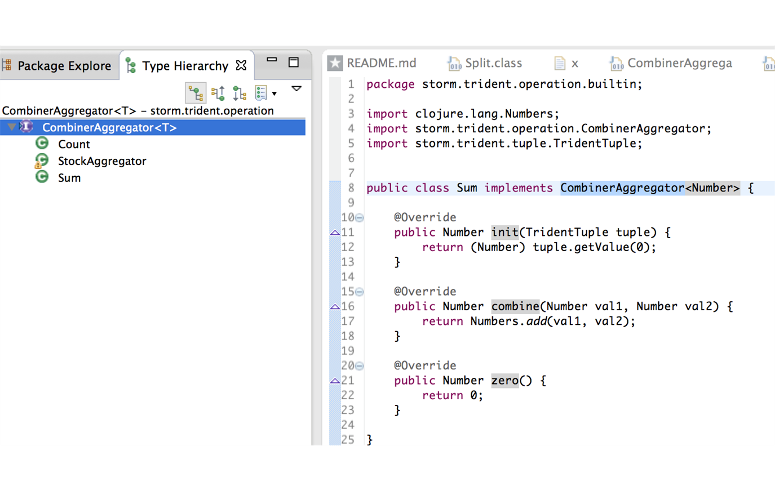
Aggregators

Slide 13
Tutorial Topologies - SimpleTridentTopology
SimpleTridentTopology
Reads information related to stocks
Places all stock trades into memory and tracks the total shares of each trade per stock via sum()
Make a simple query to obtain the total volume of trades for each stock

Slide 14
Tutorial Topologies – StockTridentTopology
StockTridentTopology
Reads information related to stocks
Places all stock trades into memory and counts the number of trades per stock via count()
Makes a simple query to obtain the total number of trades for each stock

Slide 15
Tutorial Topologies - StockStatsTridentTopology
StockStatsTridentTopology
Reads information related to stocks
Gather the stats for each stock and aggregate
Make a simple query to display the stats

Slide 16
Show Me The Running Code!
Simple Trident Topology + DRPC
Custom Trident CombinerAggregator

Slide 17
Storm Support - Hortonworks
Involvement
Storm on YARN
Adding to Hortonworks Data Platform (Ambari, delivering connectors (bolts/spouts) such as Hbase, Kafka, Hbase, JMS, etc.)
Roadmap
Kerberos support for Nimbus
Hive connectors
User authorization for topologies
Ambari topology management/monitoring
Simplified topology development

Slide 18
We’re Hiring!
thinkbig.teradata.com
Contact:
ron.bodkin at thinkbig.teradata.com
thinkbig.teradata.com
Github:
https://github.com/dmoore247/storm-trident-tutorial

Slide 19
Exercise 1: Change Computations
Round the price of shares to the nearest dollar
Can you debug to verify your calculation made a difference?

Slide 20
Exercise 2: Volume Filters
Can you write a query to only return symbols with a total volume over 1,000,000?

Slide 21
Exercise 3: Global Aggregation
Can you create a global aggregator to compute total volume of all shares?

Slide 22
Exercise 4: Windows
Can you keep a running tally of share volume for each of the last few minutes for a stock?
Hint: it’s ok to hard code knowledge that the stream starts on 2013-03-01 09:30:00
Debug to verify your tally is working
Update the DRPC to retrieve the last few minutes of values
Can you read the time in minutes from the stream instead of hard coding?

Slide 23


Thank you!
Altan Khendup (@madmongol)
Ron Bodkin (@ronbodkin)

Slide 24
Bonus Exercise
Implement variance
Implement ntiles

Slide 25
Exercise 4: Distinct Counts
Update your code to how many of the last N minutes that a given stock traded in, e.g.,
Minute 1: AAPL traded
Minute 3: AAPL, GE traded
Minute 7: GE traded
Minute 9: AAPL traded
If you query AAPL you get 3
If you query GE you get 2

